Slide 1
2021年4月暨阳联考

Slide 2
Reading B

Slide 3
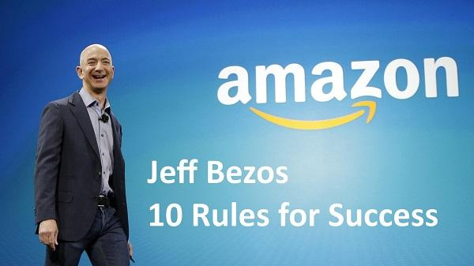
Who is JeffBezos?
What's his rule at Amazon?
If a team can't be fed by two pizzas then that team
is too large.
如果两个披萨都喂不饱一个团队，那说明它太大了。

Slide 4
The Structure of the Passage
Two pizza rules
Supporting evidence two
Introduction
Supporting evidence three
Conclusion
Supporting evidence one
The Ringelmanne Effect
A report in 2013
Social loafing
Small Teams are better than Larger Ones.

Slide 5
27.What can be a suitable title for the text？
A. What Makes a Team More Productive？
B. Why Are Smaller Teams Better Than Larger Ones?
C. How Can Two Pizzas Be Shared by One Team？
D. Which Is More Important: Individual Effort or Team
Size？

Slide 6
This experiment was recreated in the 1970’s by Alan Ingham who came up with the concept of “social loafing” which helps us understand why the individual effort decreases as the team size increases. So why does this happen? Because it becomes harder to extract the individual contributions and performance of each person.
recreated
25. What is special about the Alan Ingham's experiment?
A. It repeated the Ringelmann Effect experiment.
B. It was based on a simple task of pulling a rope.
C. It aimed to explore the reason behind the phenomenon.
D. It revealed the link between team size and individual
effort.
revealed the link
D ?
它揭示了团队规模和个人努力之间的关系。
revealed the reason behind the phenomenon

Slide 7
Sentence Analysis
It's no coincidence that smaller organizations are oftentimes more nimble while large organizations look like they are stuck in the mud.
小公司往往更灵活，而大公司却深陷泥潭，这并非巧合。
26.Which of the following words can replace the
underlined word "nimble” in the last paragraph？
A. Balanced. B. Complicated.
C. Simple. D. Flexible.

Slide 8
Reading A

Slide 9
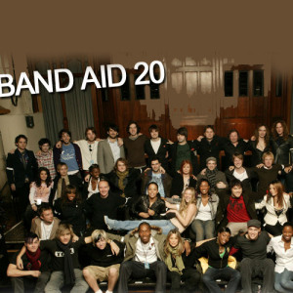
Background Information
1984年，非洲的埃塞俄比亚遭遇特大干旱，饿殍遍野。BBC的记者Michael Burke从非洲发回一系列关于饥荒的报道，英国举国震惊。音乐人Bob Geldof遂即提出构想，召集数十位当红艺人以Band Aid（救援乐队）为名，共同录制单曲义卖，将所得
用于捐助非洲饥民。单曲《他们知
道今天是圣诞节吗》（Do they
know it’s Christmas）于是诞生。

Slide 10
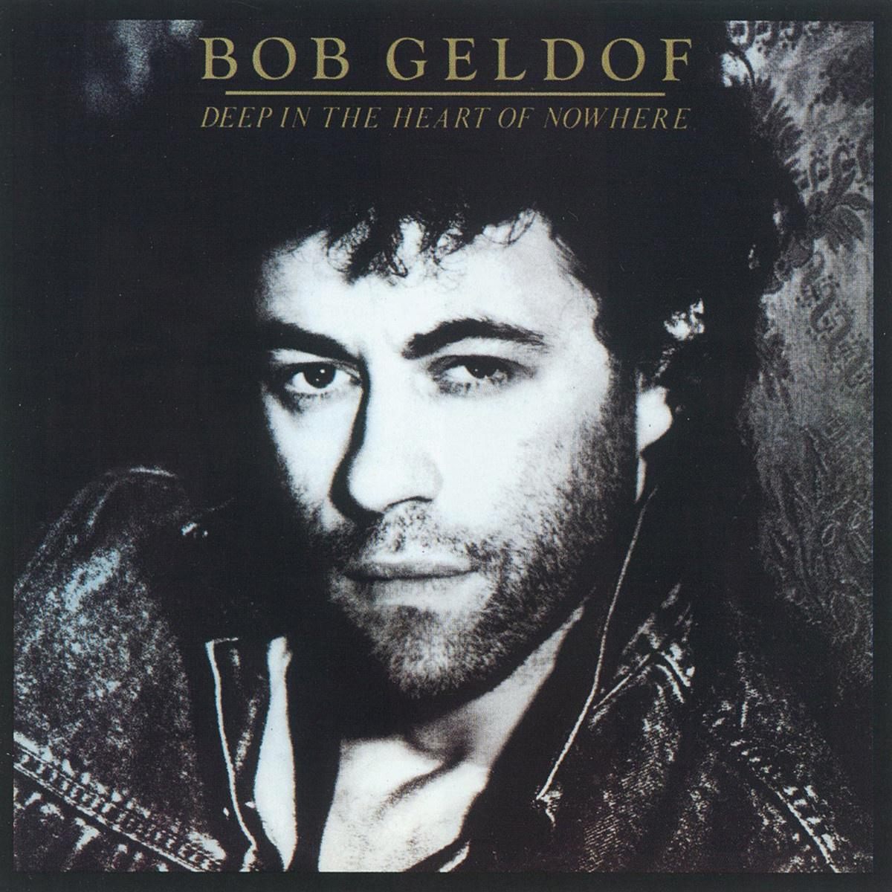
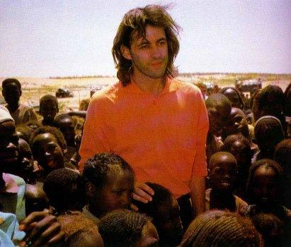
Who is Bob Geldof?
the lead singer and songwriter
of an Irish music band
The Boomtown Rats

Slide 11
The song was "Do They Know It's Christmas” By the last day of 1984, 3 million copies had been sold in Britain. It went on to sell nearly 12 million worldwide. Some people bought extra copies, and gave them away or donated them back to resell.
Geldof's next step was to organize charity super-concerts called Live Aid in London and Philadelphia, and streamed them live on television，raising an additional US $ 48 million. He was made a knight by Queen Elizabeth II, recognizing him for his activism and anti-poverty work for Africa.
gave them away
donated them back to
再结合本文主题
22. Why did some people buy extra copies of the song?
A. To have more songs to enjoy.
B. To support Bob Geldof's music career.
C. To help the starving children in Ethiopia.
D. To show their deep affection for Band Aid.
D ?

Slide 12
Words & Phrases
famine n.
Ethiopia n.
ghastly adv.
perspective n.
bestseller n.
向……致谢；正式感谢 vt.
sympathetic adj.
热门歌曲
在电视上直播
地球上最接近地狱的东西
[ˈfæmin]
饥荒
[ˌi:θi'əʊpiə]
埃塞俄比亚
[ˈgɑ:stli]
可怕地
[pəˈspektiv]
观点；看法；洞察力
畅销书
recognize
[ˌsimpəˈθetik]
同情的，怜悯的
a hit song
stream live on television
the closest thing to hell on the earth

Slide 13
Geldof’s next step was to organize charity super-concerts called Live Aid in London and Philadelphia, and streamed them live on television，raising an additional US $ 48 million.
Geldof的下一步是在伦敦和费城组织名为“现场援助”(Live Aid)的慈善超级音乐会，并通过电视直播，额外筹集了4800万美元。
仿写：他的下一步是组织名为“现场爱”的慈善活动，并通过电视直播，额外筹集了1000万元。
His next step is to organize an charity activity ______ ______ ______, and _________ it ____ on TV, _________ an __________ 10 million yuan.
called
Live Love
streamed
live
raising
additional

Slide 14
stream them love on television
1)to move or pour out in a continuous flow
血从她头上流出来
Blood was streaming from her head.
2)to move somewhere in large numbers, one after the other
桥上行人川流不息
People streamed across the bridge.
3)to move freely, especially in the wind or water 飘动；飘扬
她的围巾在身后飘动。
Her scarf streamed behind her.

Slide 15
Deeply upset and saddened (sad)by the report, Geldof decided to do something about it using (use) the language of pop music.
He was made a knight by Queen ElizabethII, recognizing (recognize) him for his activism and anti-poverty work for Africa.

Slide 16
Deeply upset and saddened by the report, Geldof decided to to do something about it using the language of pop music.
Geldof对这一报道深感不安和难过，于是决定用流行音乐做点什么。
因为很悲伤，她痛苦地抽泣着，品尝着泪水中的咸味。
_________ with grief, she sobbed bitterly, ________ the salt from the tears that __________ down her face.
这只鸟摔得头破血流，奄奄一息，折断的翅膀毫无生气地悬挂在干草上，徒劳地拍了几下翅膀，然后没了生机
Shattering and bleeding, the bird was dying, the broken wing hanging on the dry grass, flapping in vains and then going lifeless.
Overcome
tasting
streamed

Slide 17
Images of hungry children and crying mothers filled the screen.
屏幕上满是饥饿的孩子和哭泣的母亲的画面。
仿写：
屏幕上满是雪覆盖了每一个屋顶，压在老树枝上的画面。
_______ that snow _________ every rooftop and weighed on the branches of old trees
_______ ______ _______.
Images
blanketed
filled the screen

Slide 18
There I saw something that placed my worries in ghastly new perspective.
在那里，我看到了一些东西，把我的担忧置于可怕的新视角。
仿写：
他的辞职使我们不知所措。
His resignation _______ us in a difficult ________.
徒劳的挣扎使鸟儿处于危险的境地
The futile struggle placed the bird in a risky situation/put the bird at risk.
placed
situation

Slide 19
In 1985,a drought in Ethiopia ______(lead) to destroyed harvests and killed cattle. Bob Geldof, ____ Irish pop singer, was greatly shocked by the catastrophe. Bob Geldof didn't hesitate to take action. He organized a charity concert which was called Live Aid _______(raise) money for people suffering from ___________ (starve) in Ethiopia. The concert was “A tale of two cities”, _______ took place in two places ----in London and in Philadelphia. The concert turned _________ to be a great success and the _______(big) stars of the time took part in it. As a result, the concert attracted _____ much audience of the world that $100 million was raised, which served as a food aid and famine relief funding. ________ doubt, Bob Geldof has proved ________(him) to be more than a great musician.
led
an
to raise
starvation
which
out
biggest
so
Without
himself

Slide 20
续写

Slide 21

1. person
Ben & the hunter （a man）
In the woods and near the lake
2. place
Before sunrise, in the winter (frost, frozen lake)
3.time
elements
4. What happened
Ben wanted to stop the hunter to shoot the bird on his land.
5. How to do
He didn’t want to fight;he wanted to surprise him.

Slide 22

Ben
The hunter
No hunting signs
The hunter ignored the signs
conflicts
The birds fled
The hunter wouldn't let go.
Ben didn’t want to fight
The hunter kept shooting.

Slide 23
Para1
Suddenly he heard a bird’s wings beating the dry grass.
Para2
There was something threatening in the man’s cool quiet voice.
Was the bird hurt or startled?
What would the hunter react to this sound?
How could Ben, unarmed, stop him to shoot the bird ?
How could Ben make him leave?

Slide 24
Paragraph 1:
Suddenly he heard a bird’s wings beating the dry grass. Ben moved quickly toward the sound and saw a colored head of a beautiful bird. The bird did not move until Ben came close. Then it tried to fly away, but one wing was broken. Ben lifted the bird and held it close against his body. The bird fought to escape, but soon lay quietly in Ben’s arms. Ben decided to take the bird home and fix its broken wings so that it could fly again. He was almost through the woods when he heard the hunter behind him. “It is mine!”

Slide 25
Paragraph 2:
There was something threatening in the man’s cool quiet voice. The hunter stepped closer and said, “Give me that bird!” Ben was frightened at first. However, when he saw the bird struggling weakly and made a wild, strange noise, he knew he could never give this bird to the hunter. This feeling gave Ben great strength, and he was no longer afraid. “This is my property. Leave here, or I call police!” Ben said assertively（果断地）. The woods were strangely quiet. To Ben’s surprise, the hunter slowly walked away. Ben carefully studied the injured wing. He stayed with the bird, smoothing its feathers, delighted to see it recovering slowly .

Slide 26
Suddenly he heard a bird’s wings beating the dry grass. Obviously, the hunter captured this sound as well. A queer sneer crept onto his face, which sent chill down Ben’s spine. “No!” Ben muttered, the pit in his stomach growing. Turning a deaf ear, the hunter quickly put the gun to his shoulder, crouched low, and sneaked up to the poor bird swiftly but quietly. As if sensing the approaching danger, the bird began frantically beating its wings against the grass, creating a harassing noise which put Ben to the verge of breaking out. Before he knew it, he had picked up a stone and heavily thrown it towards the hunter. A snort escaping from his nose, the hunter slowly turned around and squeezed the words through clenched teeth, “Go away. It’s none of your business.”

Slide 27
Suddenly he heard a bird’s wings beating the dry grass. Obviously, the hunter captured this sound as well. A queer sneer crept onto his face, which sent chill down Ben’s spine. “No!” Ben muttered, the pit in his stomach growing. Turning a deaf ear, the hunter quickly put the gun to his shoulder, crouched low, and sneaked up to the poor bird swiftly but quietly. As if sensing the approaching danger, the bird began frantically beating its wings against the grass, creating a harassing noise which put Ben to the verge of breaking out. Before he knew it, he had picked up a stone and heavily thrown it towards the hunter. A snort escaping from his nose, the hunter slowly turned around and squeezed the words through clenched teeth, “Go away. It’s none of your business.”

Slide 28
Suddenly he heard a bird’s wings beating the dry grass. Obviously, the hunter captured this sound as well. A queer sneer crept onto his face, which sent chill down Ben’s spine. “No!” Ben muttered, the pit in his stomach growing. Turning a deaf ear, the hunter quickly put the gun to his shoulder, crouched low, and sneaked up to the poor bird swiftly but quietly. As if sensing the approaching danger, the bird began frantically beating its wings against the grass, creating a harassing noise which put Ben to the verge of breaking out. Before he knew it, he had picked up a stone and heavily thrown it towards the hunter. A snort escaping from his nose, the hunter slowly turned around and squeezed the words through clenched teeth, “Go away. It’s none of your business.”

Slide 29
Suddenly he heard a bird’s wings beating the dry grass. Obviously, the hunter captured this sound as well. A queer sneer crept onto his face, which sent chill down Ben’s spine. “No!” Ben muttered, the pit in his stomach growing. Turning a deaf ear, the hunter quickly put the gun to his shoulder, crouched low, and sneaked up to the poor bird swiftly but quietly. As if sensing the approaching danger, the bird began frantically beating its wings against the grass, creating a harassing noise which put Ben to the verge of breaking out. Before he knew it, he had picked up a stone and heavily thrown it towards the hunter. A snort escaping from his nose, the hunter slowly turned around and squeezed the words through clenched teeth, “Go away. It’s none of your business.”

Slide 30
There was something threatening in the man’s cool quiet voice. Ben was dumbfounded---for a shot moment. But the thought of protecting everything in the woods finally conquered the fear. Summoning up all his courage, Ben walked straight towards the hunter. He bent down, searching the grass for the bird, and knelt down, hold the adorable creature in his hands, stroking ti and comforting it. Then he rose to his feet, looked directly into the hunter’s eyes, “It’s so lovely, isn’t it?” Unconsciously, the hunter had put the gun down. After a long silence, he eventually nodded and said softly, “Yes.” Ben smiled. The sun emerged from beneath the horizon, hitting everything with charming light. The frost finally cleared away.

Slide 31
There was something threatening in the man’s cool quiet voice. Ben was dumbfounded---for a shot moment. But the thought of protecting everything in the woods finally conquered the fear. Summoning up all his courage, Ben walked straight towards the hunter. He bent down, searching the grass for the bird, and knelt down, hold the adorable creature in his hands, stroking it and comforting it. Then he rose to his feet, looked directly into the hunter’s eyes, “It’s so lovely, isn’t it?” Unconsciously, the hunter had put the gun down. After a long silence, he eventually nodded and said softly, “Yes.” Ben smiled. The sun emerged from beneath the horizon, hitting everything with charming light. The frost finally cleared away.

Slide 32
Para1 Suddenly he heard a bird’s wings beating the dry grass. Ben took a deep breath. “Without doubt,” he thought, “the bird exposed its spot to the human predator who was watching over these grass land.” Just at the very moment when the hunter was targeting the bird and was about to trigger, Ben shouted at the top of his voice “Stop!” It startled both the bird and the hunter – the bird soared up to the sky and the man abruptly put down the gun. He sternly turned around toward the direction where Ben stood, “Who are you doing here ?”

Slide 33
Para2 There was something threatening in the man’s cool quiet voice. Ben straightened his back and replied the intruder’s confrontation(对峙；对抗） with as much determionation and assurance as he could summon up or fake, “I am the landlord of this place and you step into my private property. I demand you leave right now.” “Is that so?” The hunter gave a snort of contempt. “Yes, I have claimed this property! LEAVE!” The hunter swung his gun and whistled, leaving at last. Ben relieved a sigh. The frost on the dry grass started to melt when the rising sun popped out from the east with sunlight dancing on the signs “No hunting”.

